Slide 1
DotaMatch
Team B11
Corey Chong
Albert Su
Evans Yeung

Slide 2
Overview
Background
Issue
Observations
Analysis
Solution
Technical Diagrams
Technical Process
Post Implementation Review
Demonstration
Q/A

Slide 3
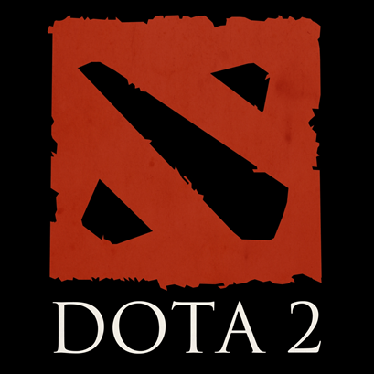
Background
Cooperative multiplayer game, MOBA
7.86 million people playing worldwide
Played by two teams of 5 players
Requires teamwork, communication, and cooperation
Focus on strategy
Current matchmaking is done on a rank system

Slide 4
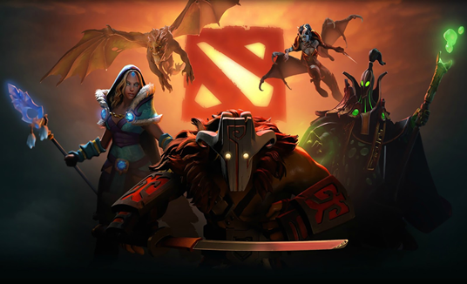
issue
Games are filled with negative attitudes
Rank does not equal skill at times
New player retention is low
Poor communication
Players don’t trust strangers

Slide 5
Observations
Dota isn’t friendly to players who play alone
Teamwork is encouraged but difficult to enforce
Some players hide behind anonymity and are hostile toward others
Language barriers
Little to no repercussions for an individual’s actions
One session is a significant time investment

Slide 6
analysis
Current matchmaking system does not help users find long term teammates
Players learn more and perform better with positive reinforcement
The best way to encourage teamwork is to make players care about their teammates

Slide 7
Solution
Create an environment where users can have a positive experience regardless of outcome
Players are able to make long term friendships
Create better games through an organized matchmaking system
Allow players to choose the type of players they wish to play with

Slide 8
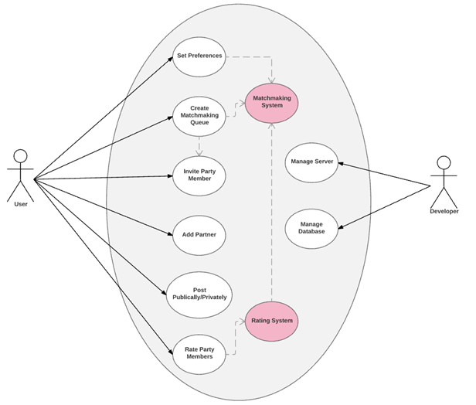
Use case Diagram

Slide 9
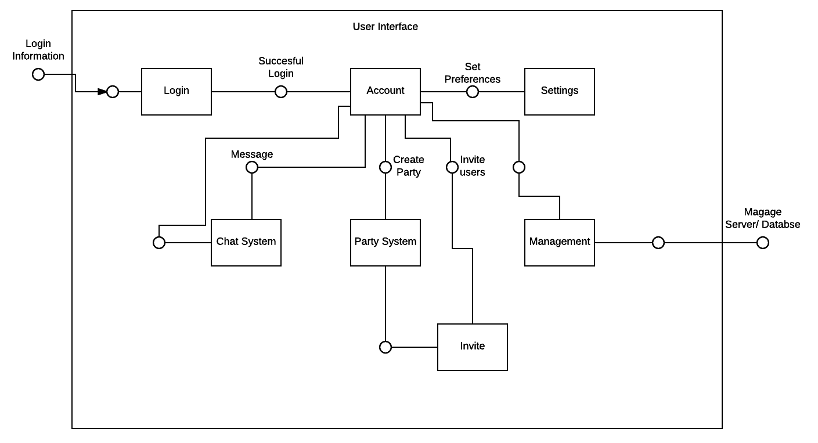
UI Component design

Slide 10
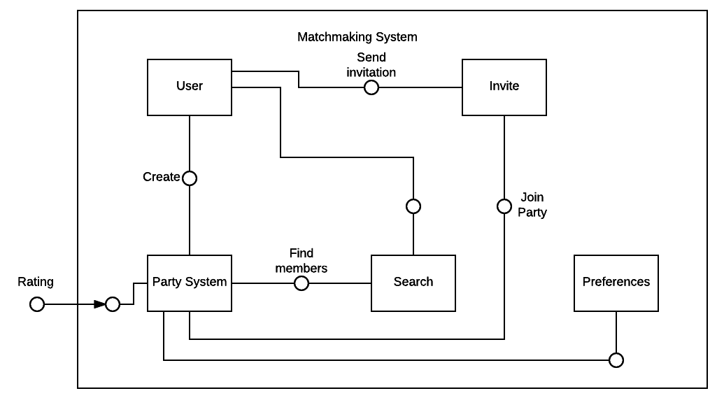
Matchmaking component design

Slide 11
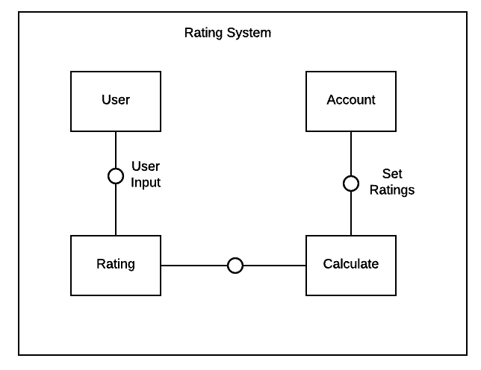
Rating component design

Slide 12
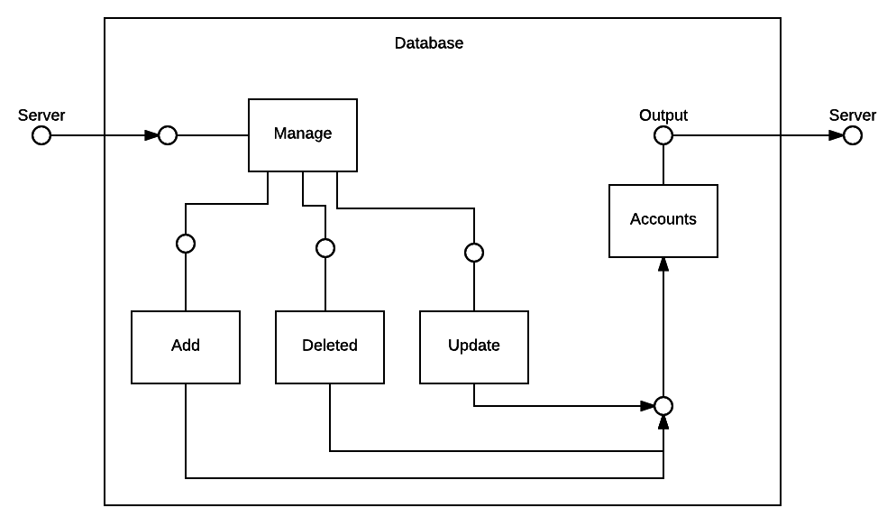
Database component design

Slide 13
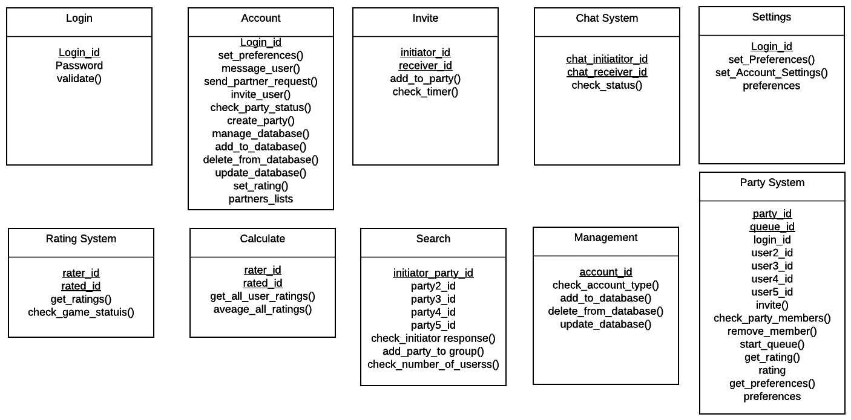
Class diagram

Slide 14
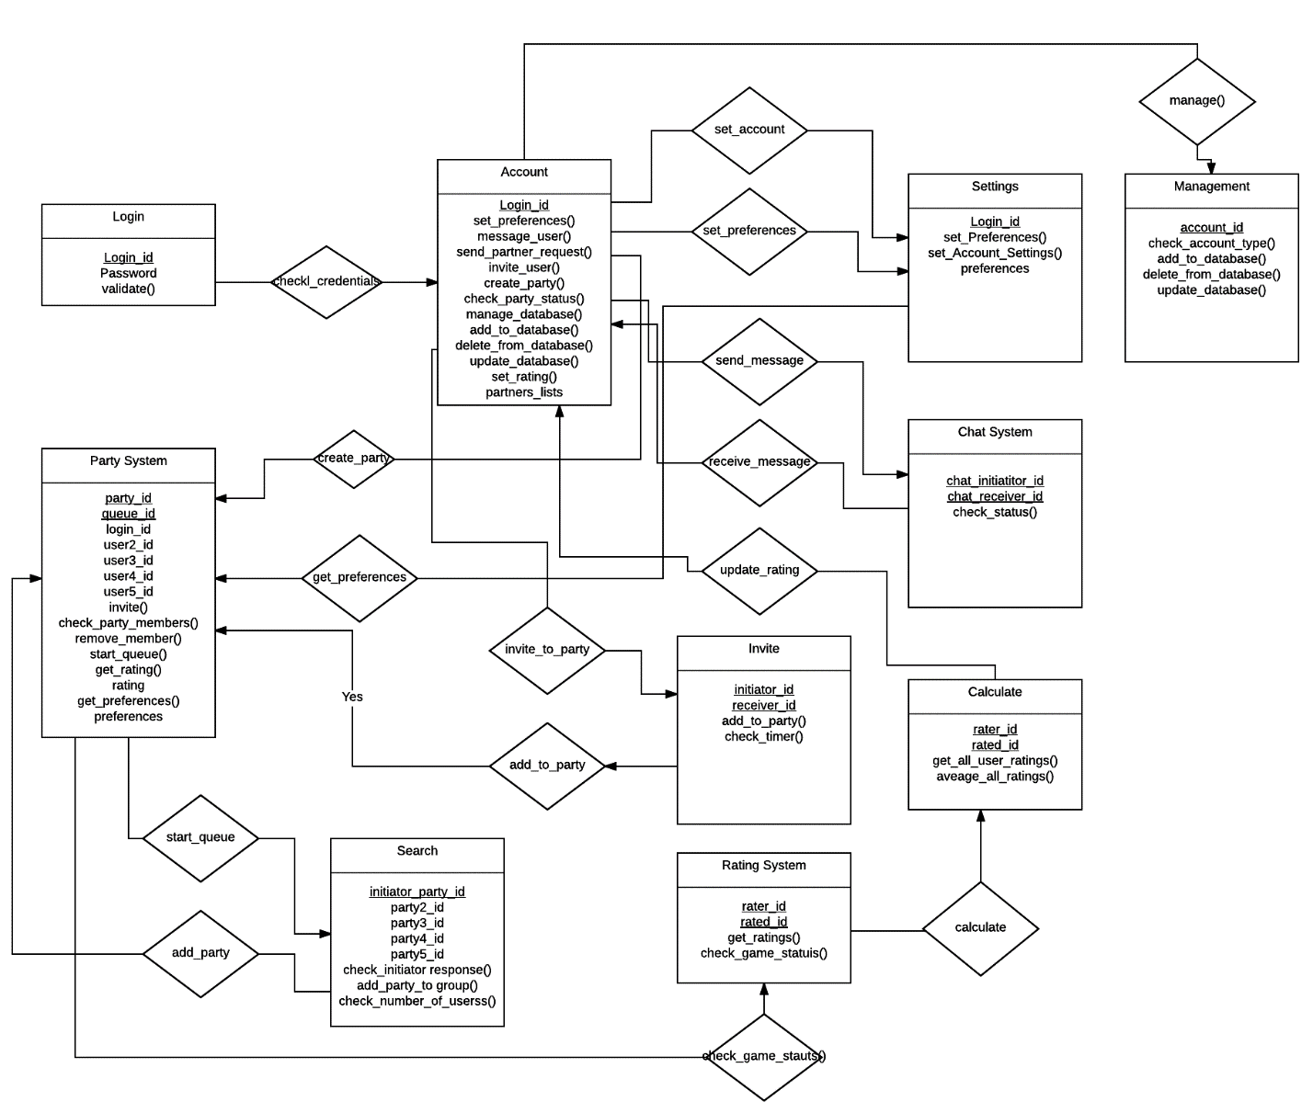
Class relationship diagram

Slide 15
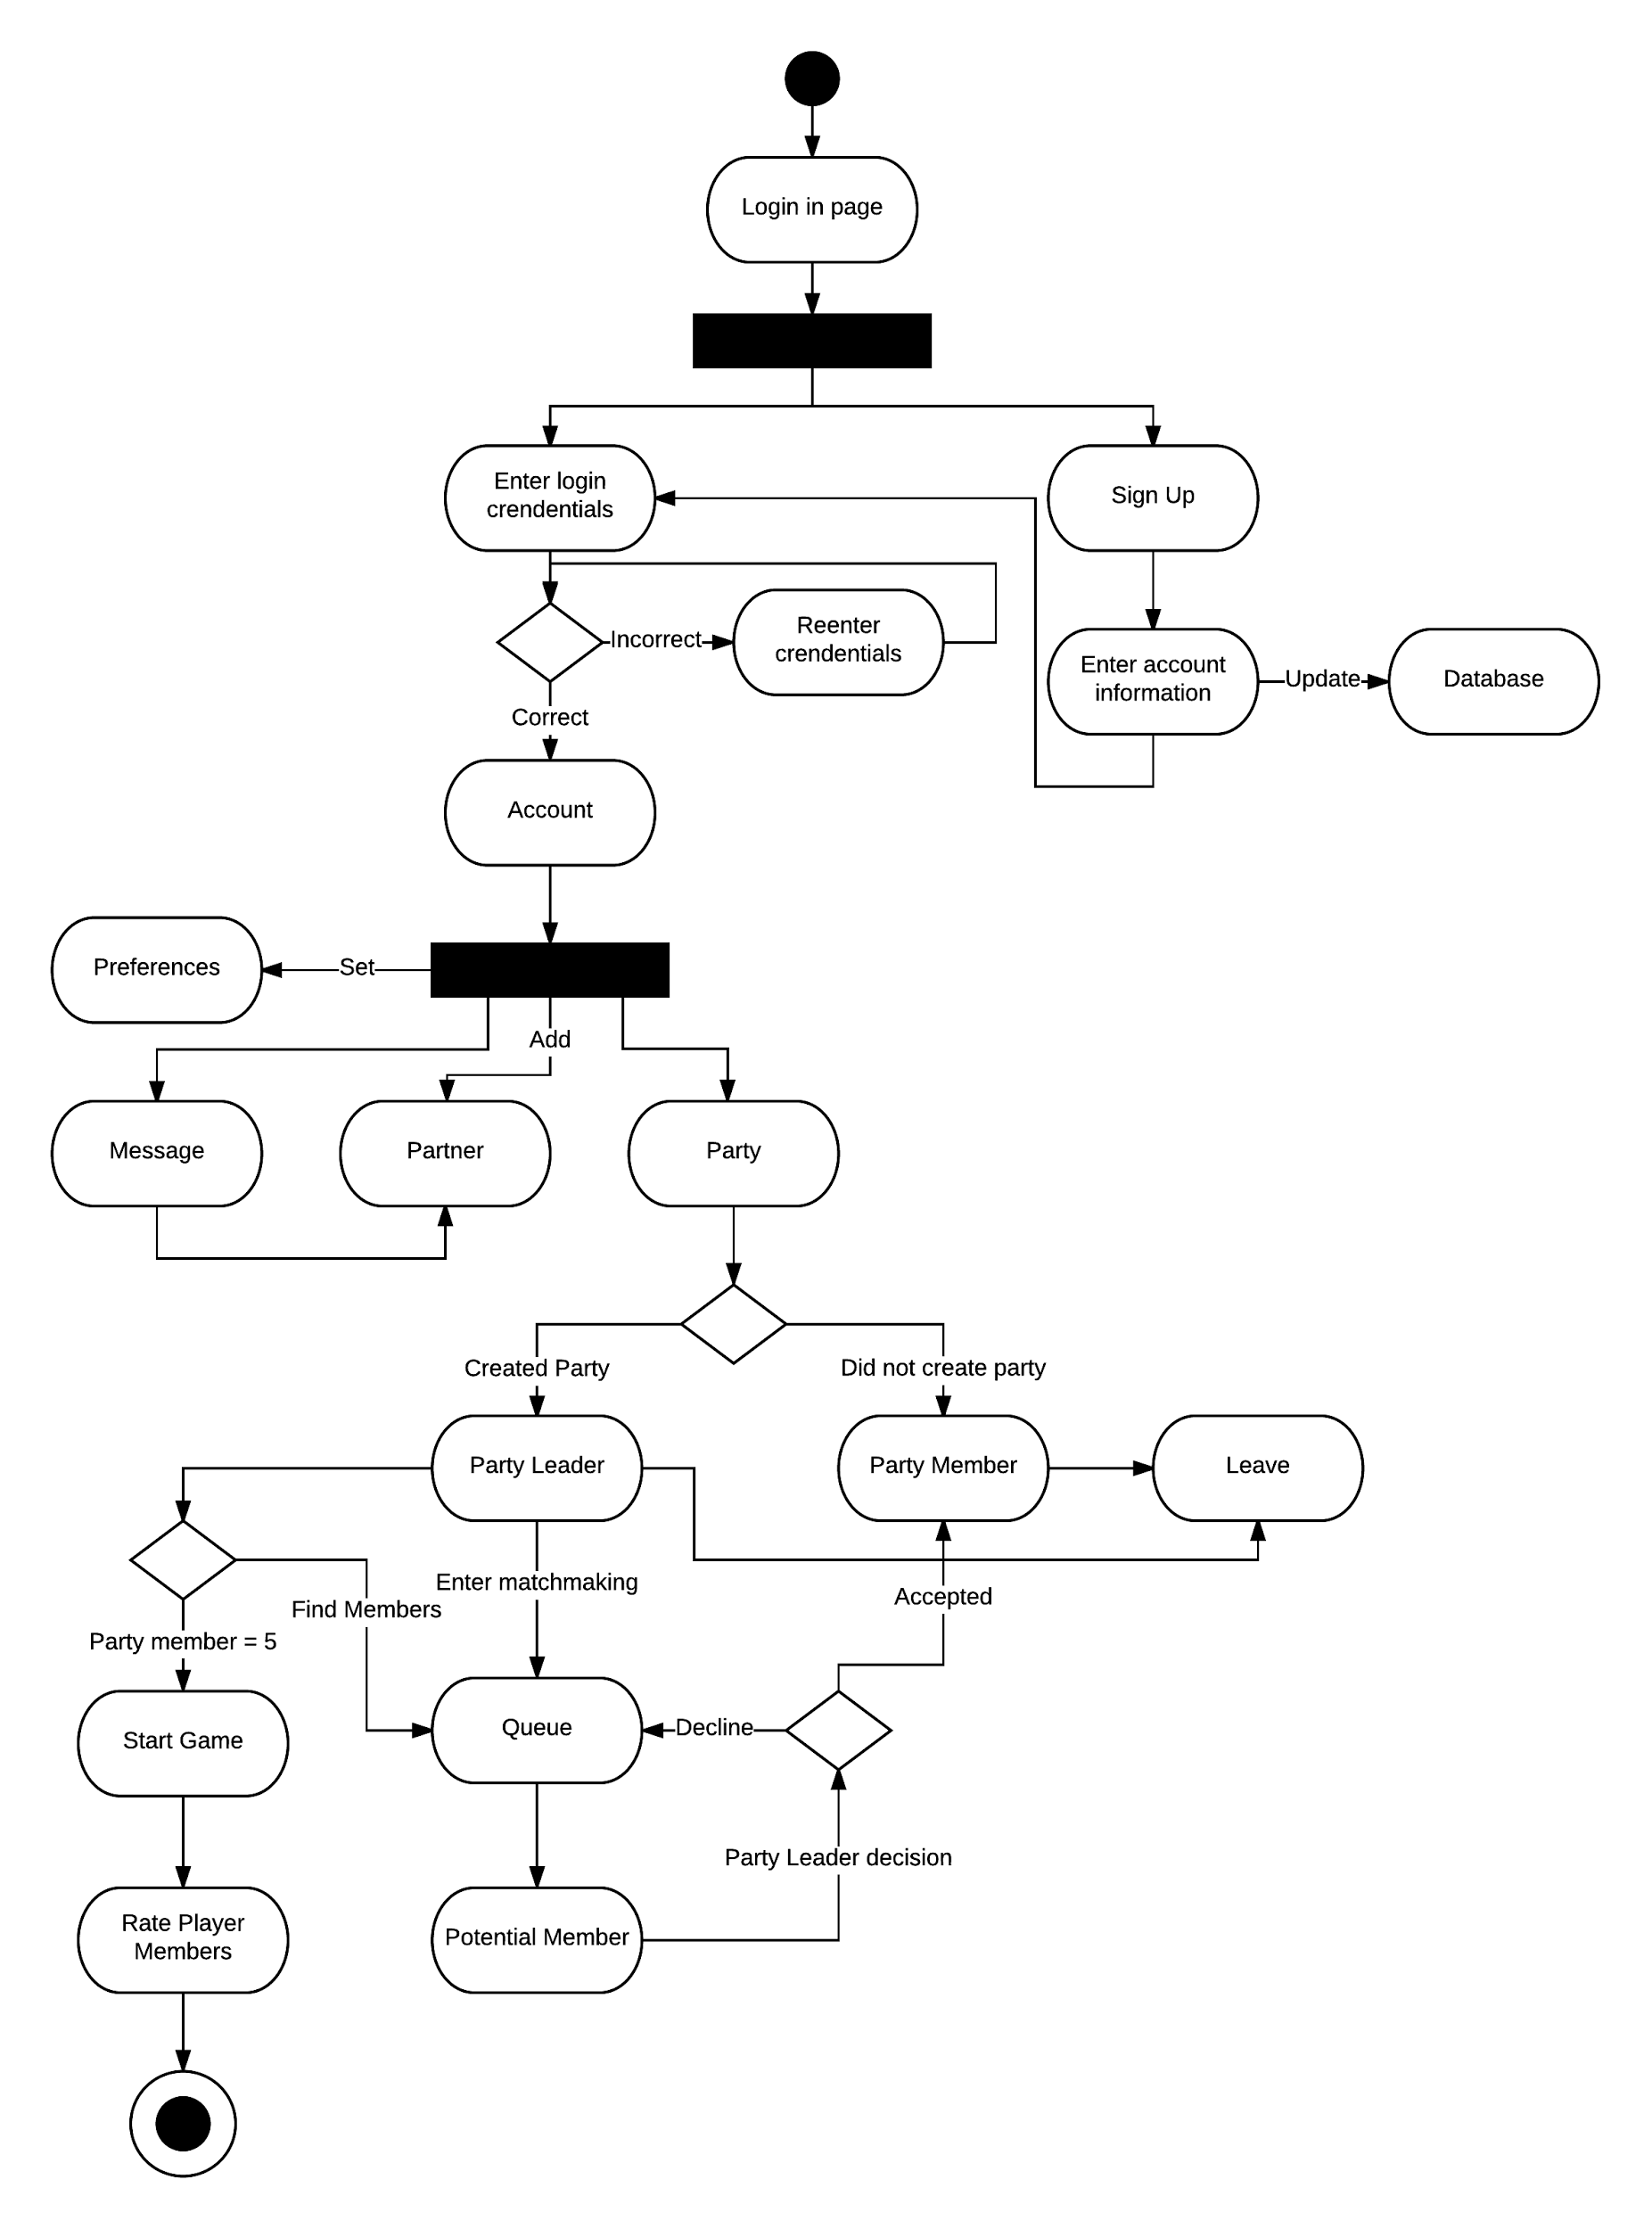
Activity diagram

Slide 16
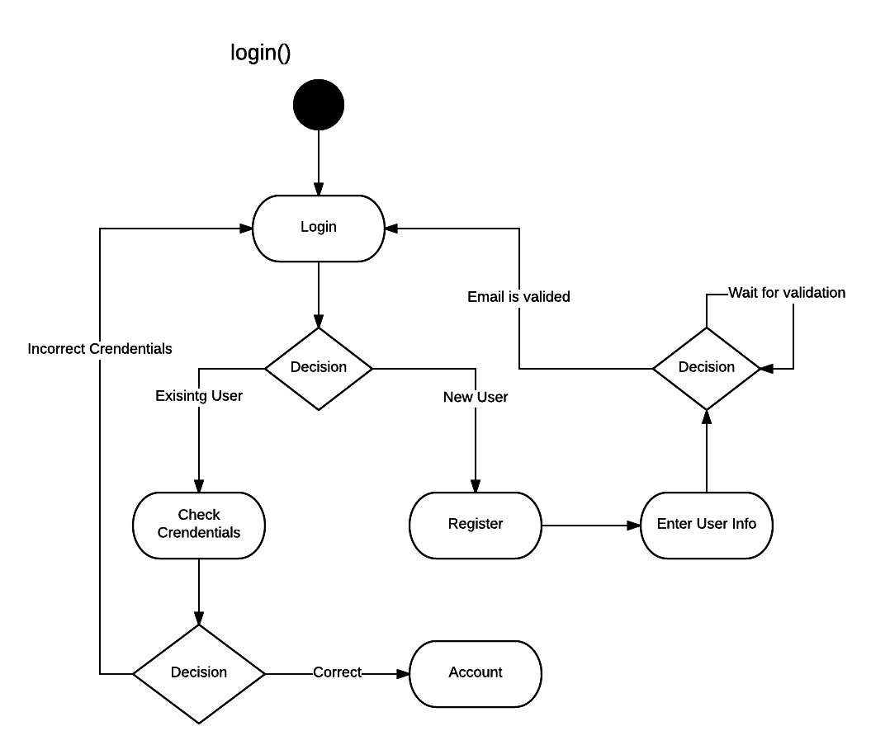
Login State diagram

Slide 17
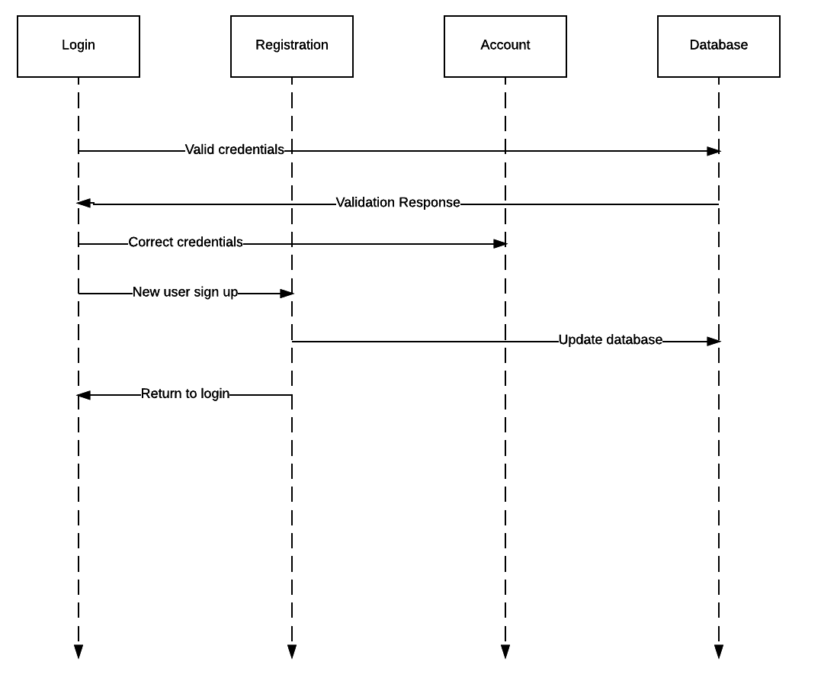
Login sequence diagram

Slide 18
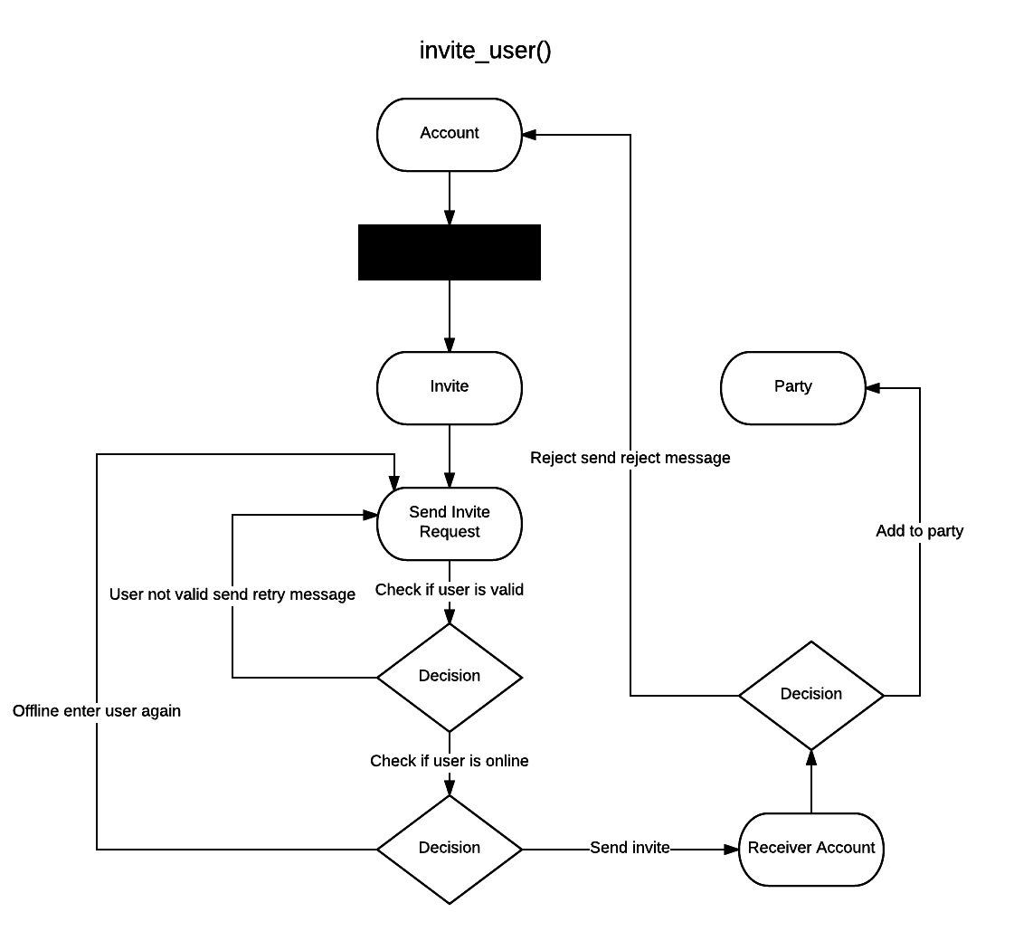
Invite State diagram

Slide 19
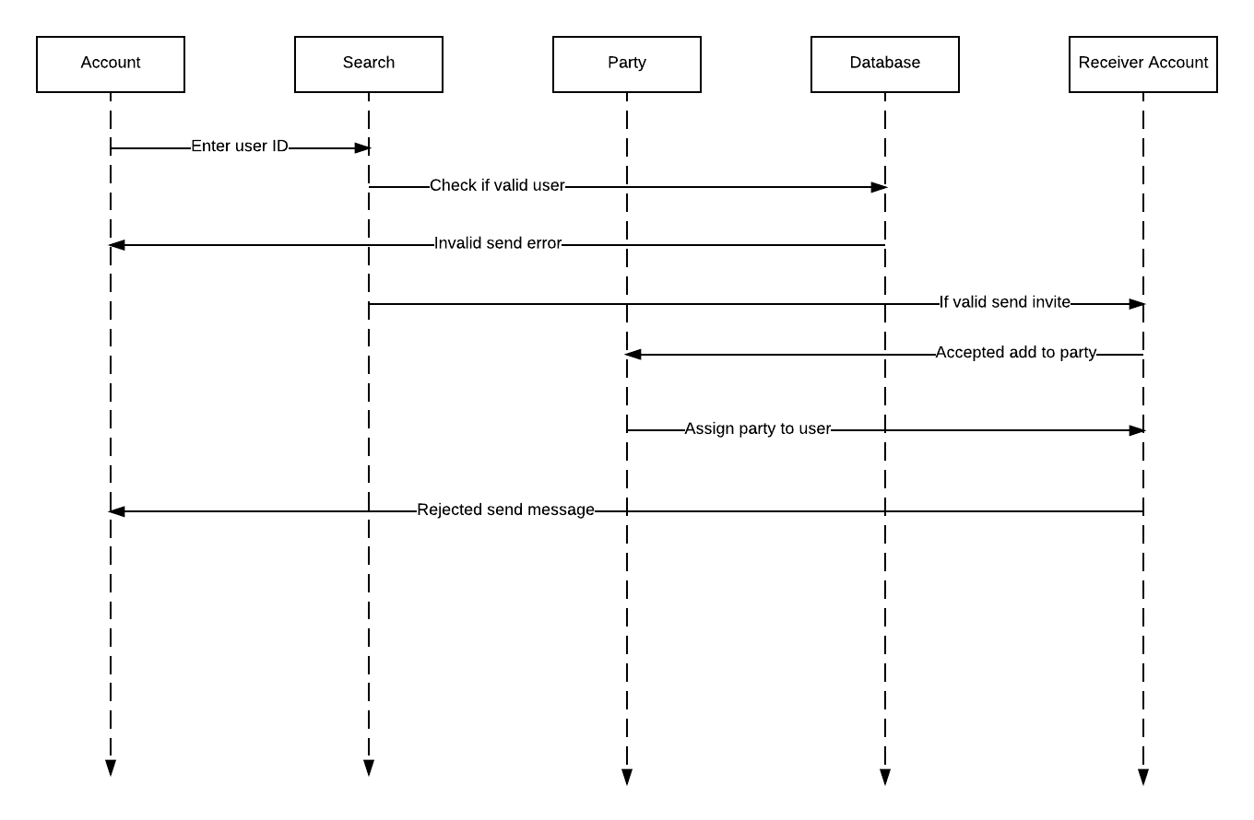
Invite sequence diagram

Slide 20
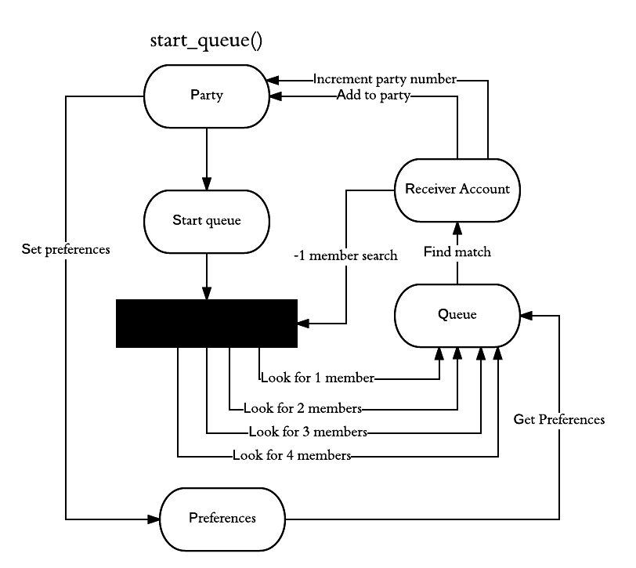
Matchmaking State diagram

Slide 21
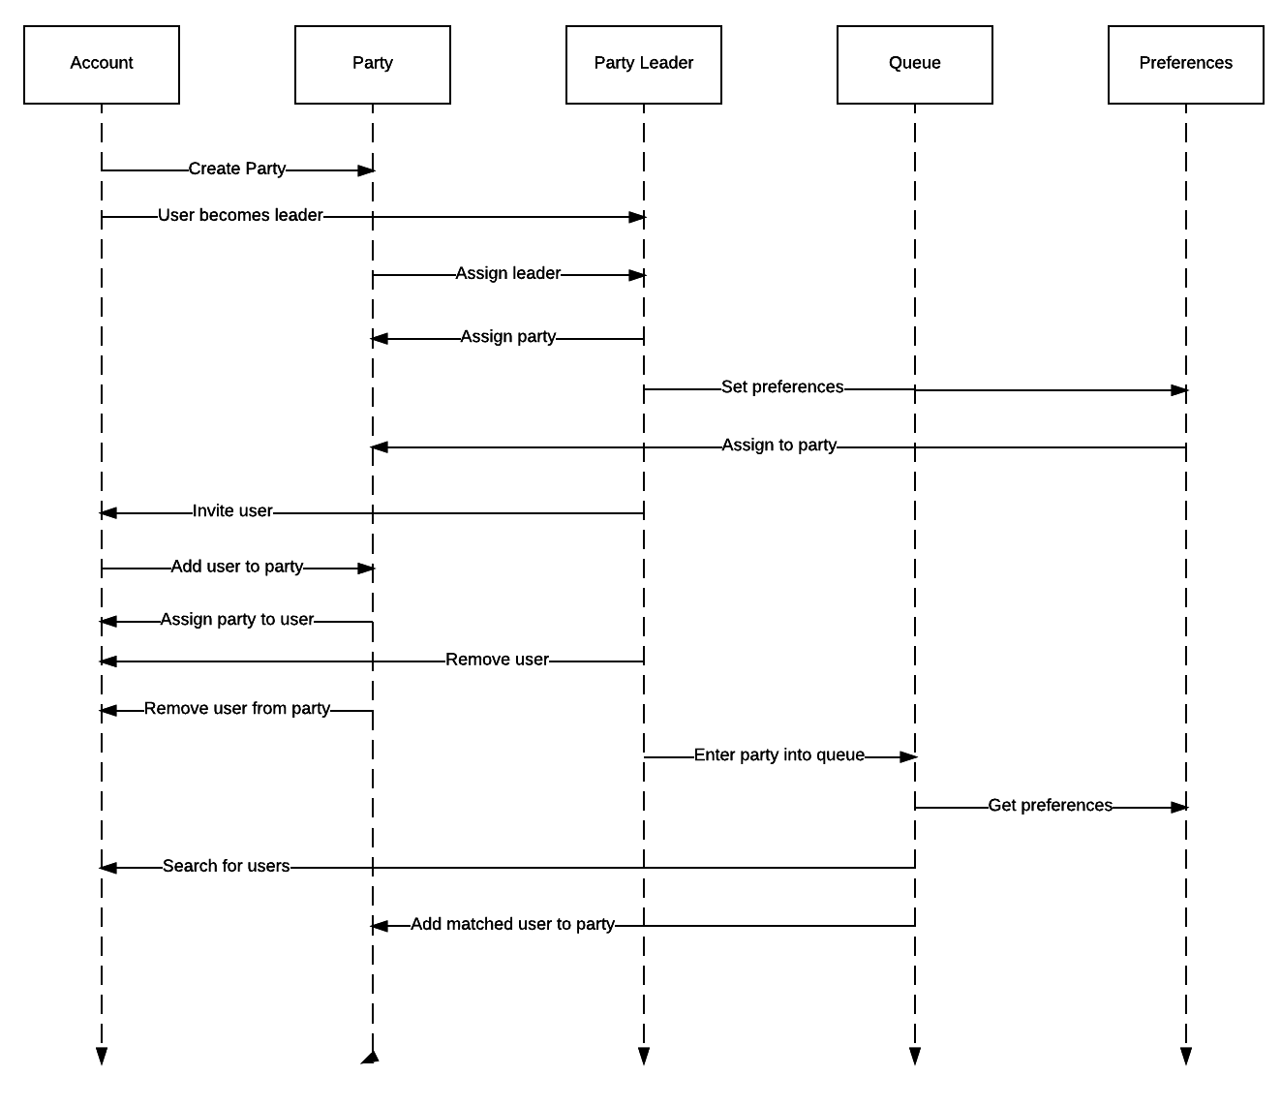
Matchmaking sequence diagram

Slide 22
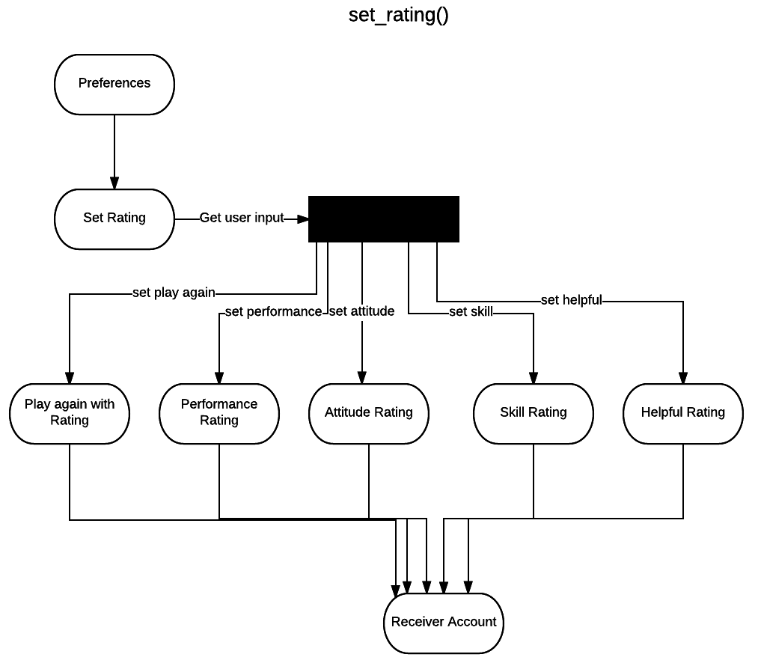
Rating State diagram

Slide 23
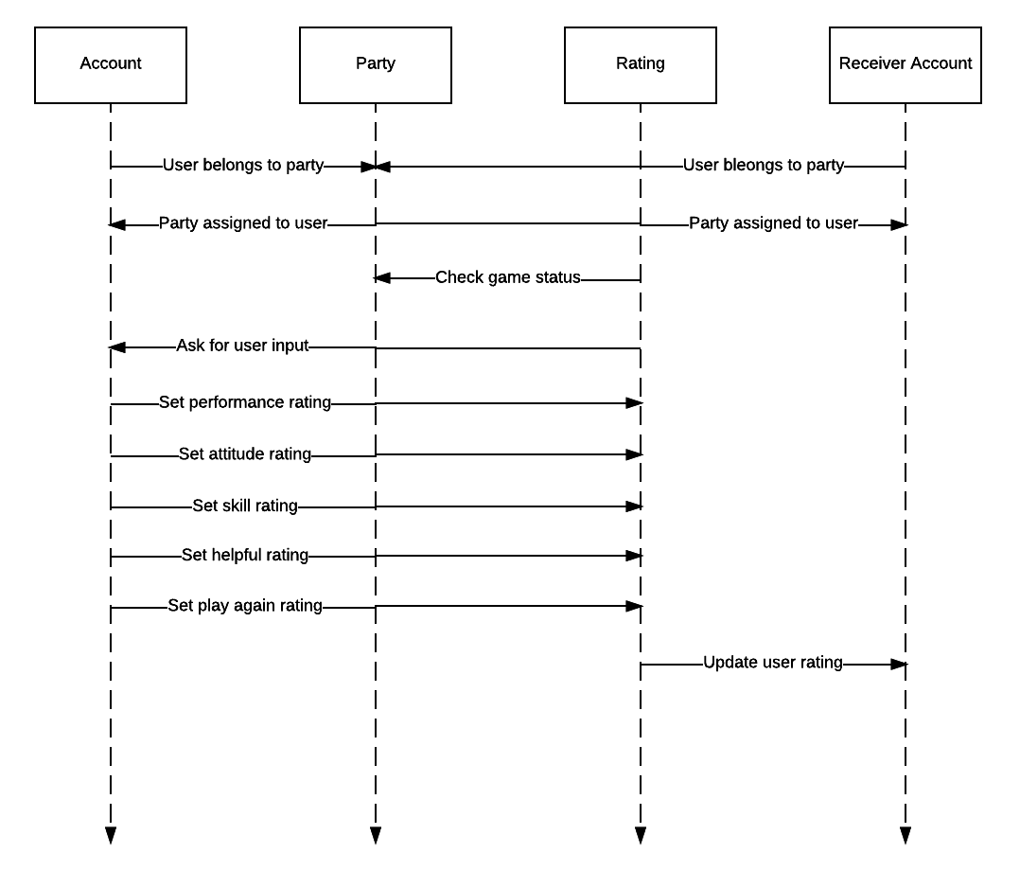
Rating sequence diagram

Slide 24
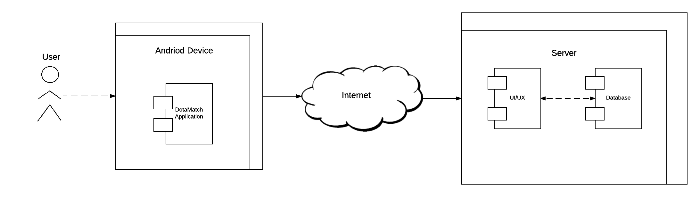
Physical deployment diagram

Slide 25
Technical Process
Democratic System
All ideas about functionality, documentation, and decisions were discussed between all members.
Communication through Facebook Messenger
Informal Meetings
Iterative and Incremental Cycle with Object Oriented Paradigm
Coding was implemented through GitHub
Version control
Self-check & review were conducted at the end of each workflow

Slide 26
Post Implementation Review
What we did right:
Overall project schedule was generally on-time
Worked well as a team
Deliverables were completed and submitted on time
What we did wrong:
Not enough self-checks & reviews
Time management
No concrete milestones
Application needs more work

Slide 27
Future growth
Eventually extend the application for general event coordination
Implement more robust match making algorithm
Portability
iOS
Web based
Convenient method of record keeping across multiple platforms

Slide 28
Demonstration

Slide 29
Questions/answers
Thank You!

